Slide 1


<Vadim Savenkov>
<30-Jul-2022>

Slide 2

Outline
Executive Summary
Introduction
Methodology
Results
Conclusion
Appendix

Slide 3
Executive Summary
Summary of methodologies
Data Collection
Data Wrangling
EDA and Data Visualization
EDA with SQL
Building an interactive map with Folium
Building a Dashboard using Plotly Dash
Predictive Analysis(Classification)
Summary of all results
EDA Results
Interactive Analytics
Predictions

Slide 4
Introduction
Project background and context
SpaceX advertises Falcon 9 rocket launches on its website, with a cost of 62 million dollars; other providers cost upward of 165 million dollars each, much of the savings because SpaceX can reuse the first stage.
Problems you want to find answers
The objective is to predict if the first stage of the SpaceX Falcon 9 will land successfully

Slide 5

Section 1

Slide 6
Methodology
Executive Summary
Data collection methodology:
SpaceX Rest API
Web Scrapping From Wikipedia
Perform data wrangling
One Hot Encoding data field for Machine Learning and data cleaning of null values and irrelevant columns
Perform exploratory data analysis (EDA) using visualization and SQL
Perform interactive visual analytics using Folium and Plotly Dash
Perform predictive analysis using classification models
Find the best Hyperparameter for SVM, Classification Trees, and Logistic Regression

Slide 7
Data Collection Flow Chart
Space X REST API
SpaceX launch data that is gathered from the SpaceX REST API.
This API will give us data about launches, including information about the rocket used, payload delivered, launch specifications, landing specifications, and landing outcome.
The SpaceX REST API endpoints, or URL, starts with api.spacexdata.com/v4/.
Another popular data source for obtaining Falcon 9 Launch data is web scraping Wikipedia using Beautiful Soup.
Get Space X REST API data
Make Space X data JSON request
Convert Space X data to DF
Normalize data and export to csv
Consolidated data
Get HTML response from Wiki
Extract data using Beautiful Soup
Create Space X DF by parsing
Web Scraping

Slide 8
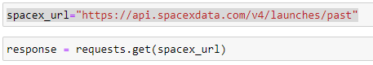
Data Collection – SpaceX API
Request rocket launch data from SpaceX API with the following URL:
To make the requested JSON results more consistent, use the static response object:
Use the json_normalize method to convert the JSON result into a data frame:
Get the API again to get information about the launches using the following IDs: rocket, payloads, launchpad, and cores.
Use Global Variables
Construct a new dataset and combine columns into the dictionary:
Create a data frame from a dictionary:
Filter data frame to only include Falcon 9 launches:
Clean data frame and export to csv:
Get requests to the SpaceX API and to do some basic data wrangling and formatting:
Request to the SpaceX API
Clean the requested data
Check the URL of the completed SpaceX API calls notebook as an external reference and for peer-review purposes:
https://github.com/vadimsavenkov/Applied_DS_Capstone/blob/main/.ipynb_checkpoints/spacex-data-collection-api-checkpoint.ipynb

Slide 9
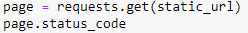
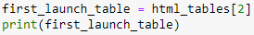
Data Collection – Web Scraping
Web scrap Falcon 9 launch records with Beautiful Soup:
Extract a Falcon 9 launch records HTML table from Wikipedia
Parse the table and convert it into a Pandas data frame
Check the URL of the completed web scraping notebook as an external reference and for peer-review purposes:
https://github.com/vadimsavenkov/Applied_DS_Capstone/blob/main/.ipynb_checkpoints/webscraping-checkpoint.ipynb
Perform an HTTP GET method to request the Falcon9 Launch HTML page, as an HTTP response
Create a Beautiful Soup object from the HTML response
Extract all column/variable names from the HTML table header
Create a data frame by parsing the launch HTML tables and filling in the parsed launch record values into the dictionary
Create a data frame and export it to CSV

Slide 10
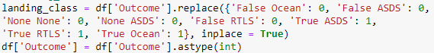
Data Wrangling
Load Space X dataset
Use the method value_counts for column LaunchSite to determine the number of launches on each site
Use the method value_counts to determine the number and occurrence of each orbit for the column Orbit
Use the method value_counts on the column Outcome to determine the number of landing_outcomes
Using the Outcome, create a list where the element is zero if the corresponding row in Outcome is in the set bad_outcome; otherwise, it's one. Then assign it to the variable landing_class and export to csv
Perform exploratory Data Analysis and determine Training Labels
Exploratory Data Analysis
Determine Training Labels
Check the URL of the completed data wrangling notebook as an external reference and for peer-review purposes:
https://github.com/vadimsavenkov/Applied_DS_Capstone/blob/main/.ipynb_checkpoints/spacex-data-wrangling-checkpoint.ipynb
Calculate the number of launches on each site
Calculate the number and occurrence of each orbit
Calculate the number and occurrence of mission outcome per orbit type
Create a landing outcome label from the Outcome column

Slide 11
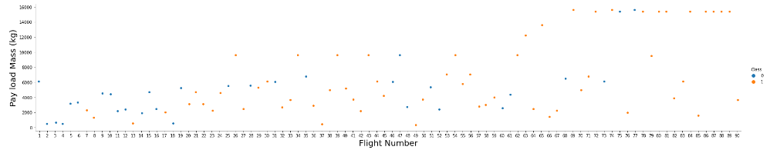
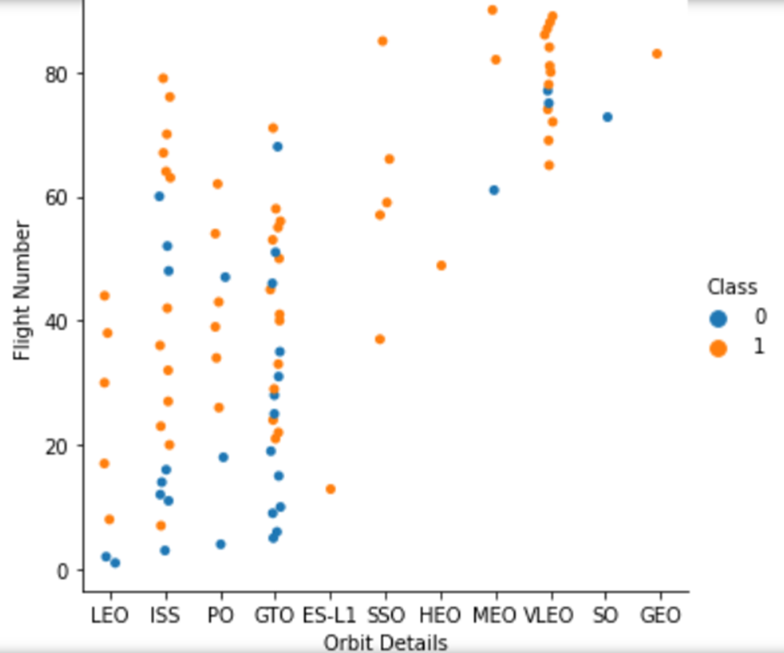
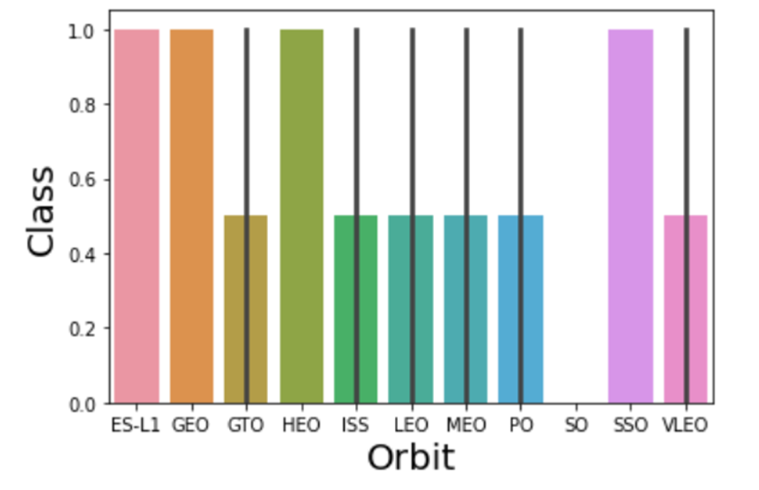
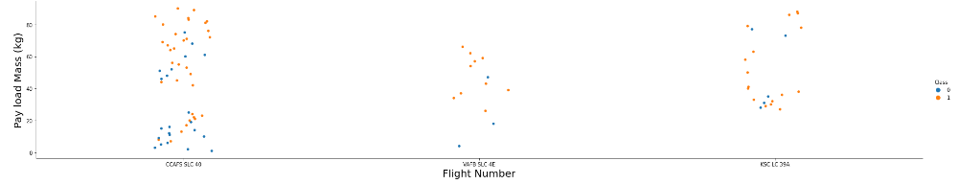
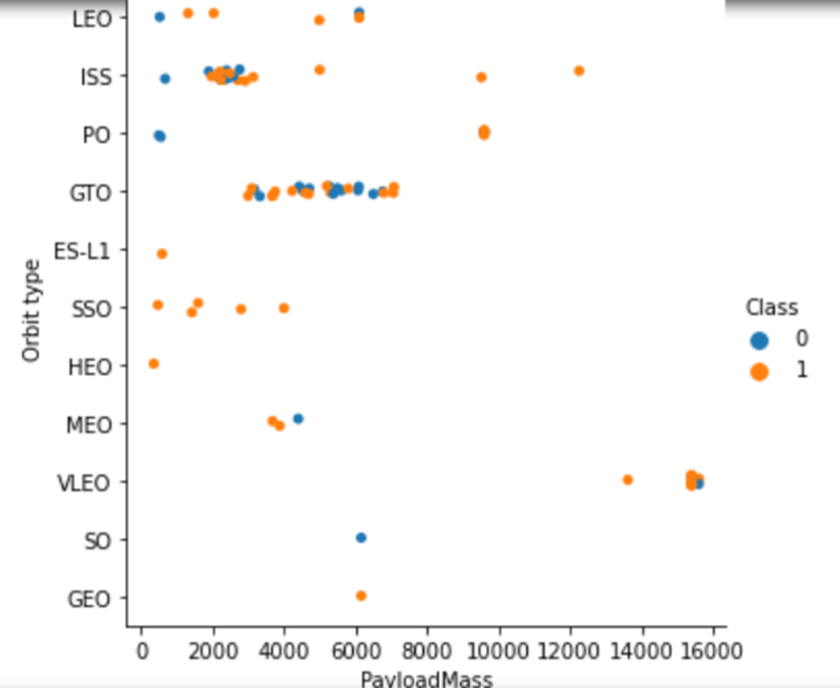
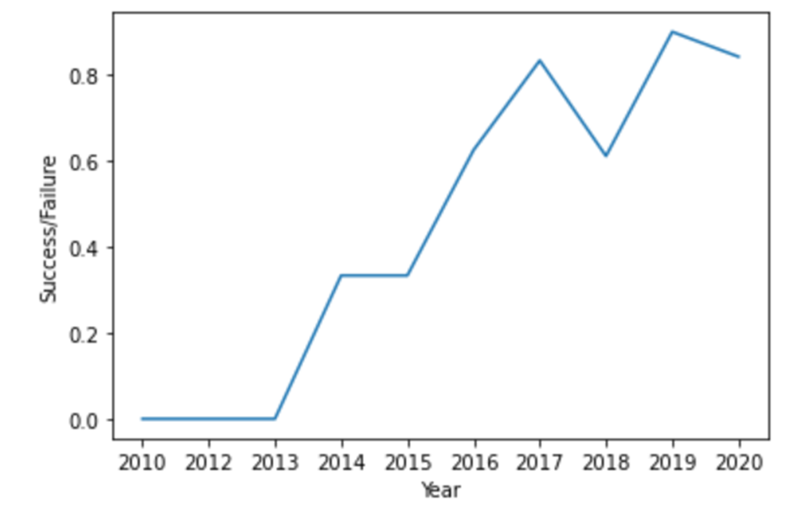
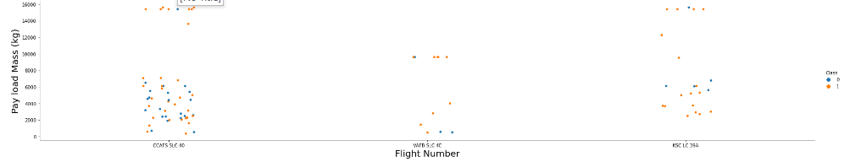
EDA with Data Visualization
Pay Load Mass vs. Flight Number
Bar chart for the success rate
of each orbit
Relationship between Flight Number
and Orbit type
Relationship between Flight Number and Launch Site
Relationship between Payload
and Orbit type
Get the average launch success trend
Relationship between Payload and Launch Site
Check the URL of the completed data visualization notebook as an external reference and for peer-review purposes
https://github.com/vadimsavenkov/Applied_DS_Capstone/blob/main/.ipynb_checkpoints/Exploratory%20Data%20Analysis%20Using%20Matplotlib-checkpoint.ipynb

Slide 12
EDA with SQL
Performed SQL queries:
Display the names of the unique launch sites in the space mission
Display 5 records where launch sites begin with the string 'CCA’
Display the total payload mass carried by boosters launched by NASA (CRS)
Display average payload mass carried by booster version F9 v1.1
List the date when the first successful landing outcome in the ground pad was achieved
List the names of the boosters which have success in drone ship and have payload mass greater than 4000 but less than 6000
List the total number of successful and failed mission outcomes
List the names of the booster_versions which have carried the maximum payload mass. Use a subquery
List the records which will display the month names, failure landing_outcomes in drone ship, booster versions, land launch_site for the months in the year 2015
Rank the count of successful landing_outcomes between the date 04-06-2010 and 20-03-2017 in descending order
Check the URL of the completed EDA with SQL notebook as an external reference and for peer-review purposes:
https://github.com/vadimsavenkov/Applied_DS_Capstone/blob/main/.ipynb_checkpoints/eda-sqllite-checkpoint.ipynb

Slide 13
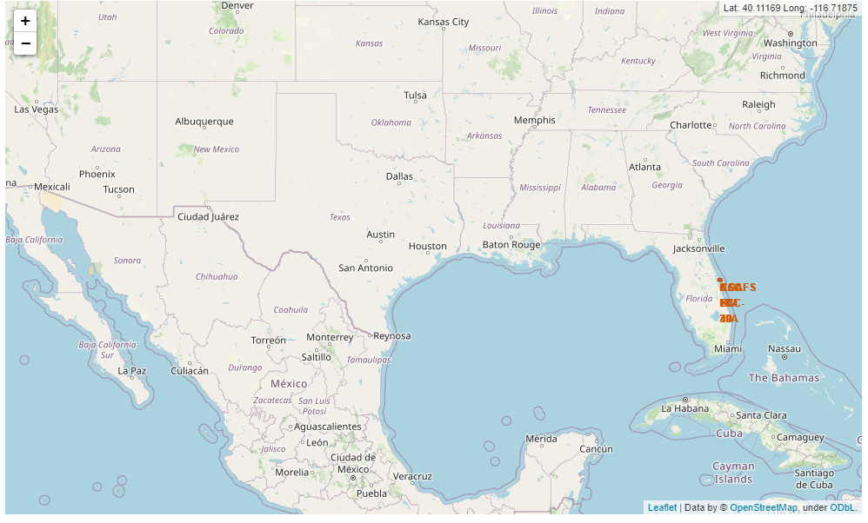
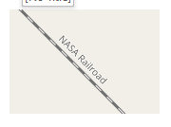
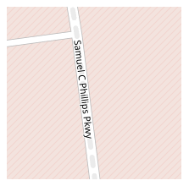
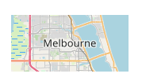
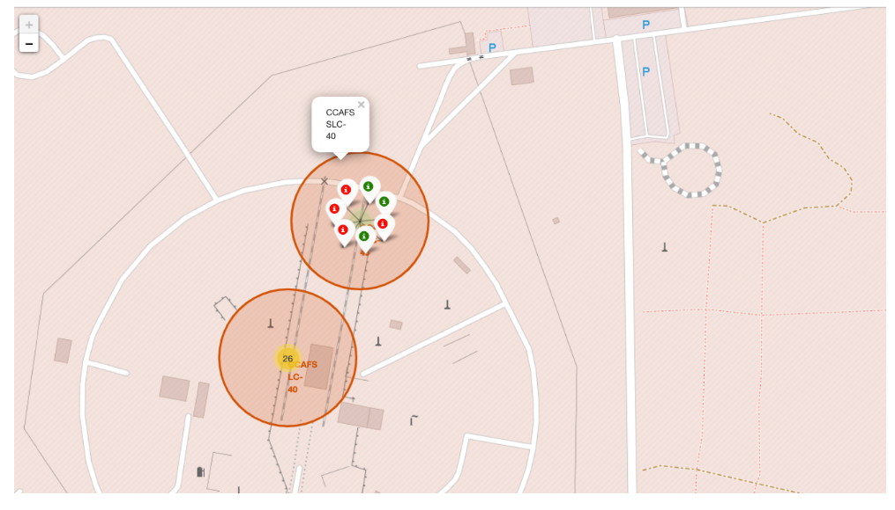
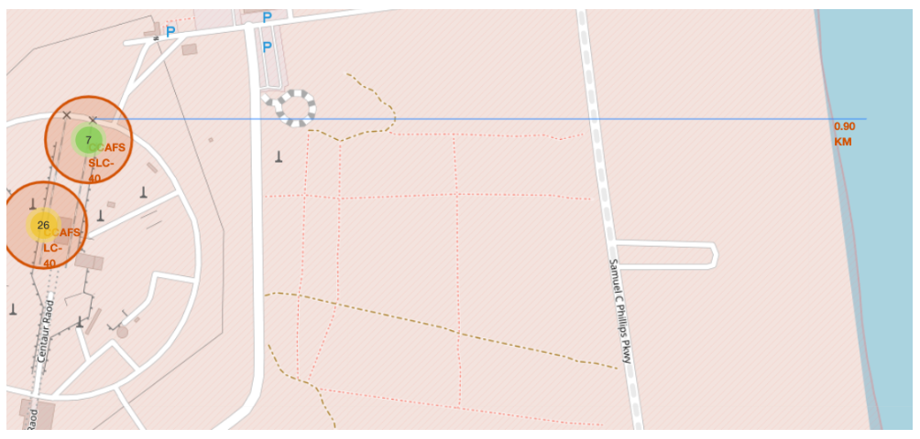
Build an Interactive Map with Folium
Markers, circles, lines, etc. were added to a folium map to analyze geographical patterns about launch sites and check the proximity to various locations
Check the URL of the completed interactive map with Folium notebook as an external reference and for peer-review purposes:
https://dataplatform.cloud.ibm.com/analytics/notebooks/v2/d00ac88b-484b-4c72-b999-64fc3d1b7d5c/view?access_token=a3c8bba52db1e2492850c95455973df3339af6c7360e242dfbc7ca190c03fe4a

Slide 14
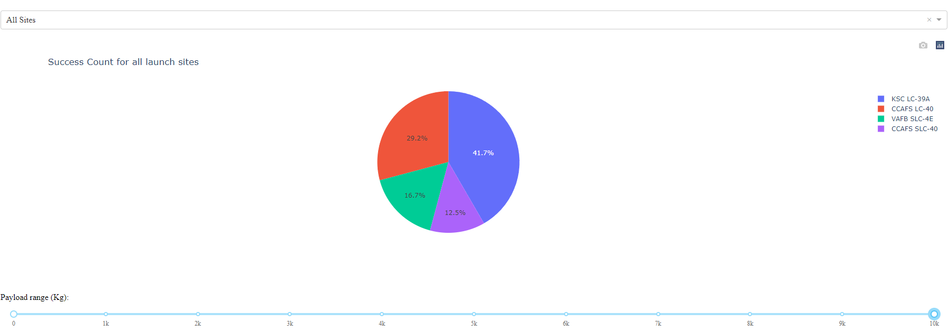
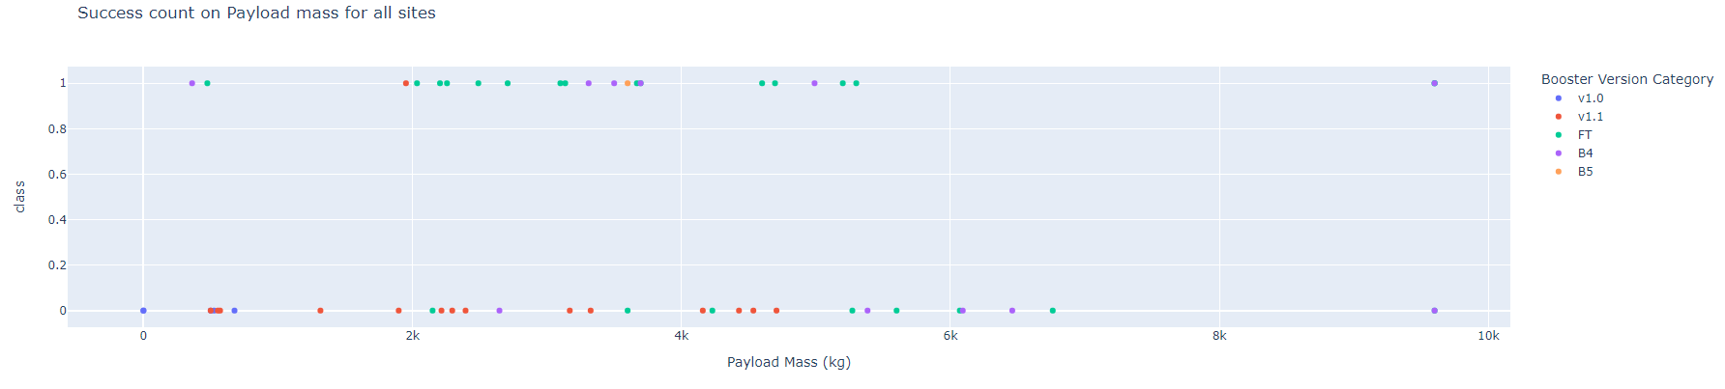
Build a Dashboard with Plotly Dash
A success count interactive dashboard using records for 4 SpaceX launch sites was created
KSC LC 39A had highest number of successful among other sites
Check the URL of the completed interactive dashboard with Plotly Dash notebook as an external reference and for peer-review purposes:
https://github.com/vadimsavenkov/Applied_DS_Capstone/blob/main/.ipynb_checkpoints/spacex_DB_app-checkpoint.ipynb

Slide 15
Predictive Analysis (Classification)
Classification
Building ML Model
Calculating Model Accuracy
Standardization
Splitting into train/test
Evaluating ML Model
Plot the Results
Building GridSearchCV
Finding Hyperparameters
Optimizing ML Model
Building Confusion Matrix
Finding Optimal Model
Check the URL of the completed predictive analysis notebook as an external reference and for peer-review purposes:
https://github.com/vadimsavenkov/Applied_DS_Capstone/blob/main/.ipynb_checkpoints/SpaceX_Machine%20Learning%20Prediction-checkpoint.ipynb

Slide 16
Results
Decision Tree model performed the best for the training data set with a score of 0.87.
Low weighted payloads perform better than heavier payloads.
The success rates for SpaceX launches shows increase with time and it will continue to grow.
KSC LC 39A launch site had the highest success count among all the other sites.
Orbit GEO, HEO, SSO, ES L1 has the best Success Rate.

Slide 17

Section 2

Slide 18
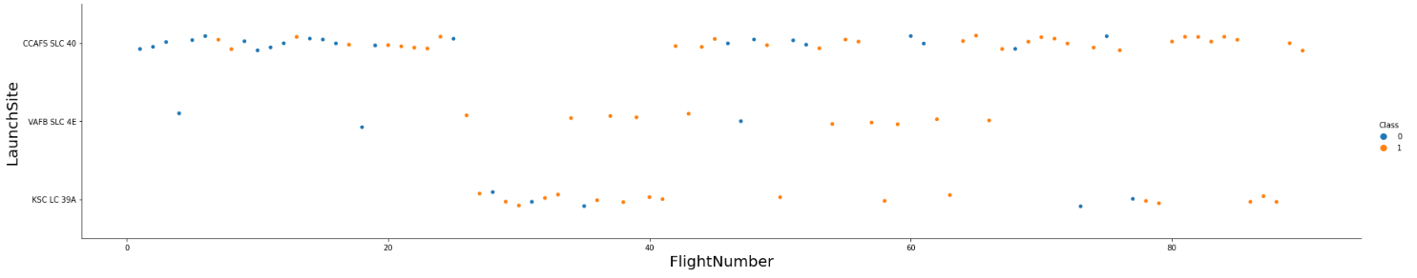
Flight Number vs. Launch Site
The success rate is increasing with increasing the number of flights. The highest number of flights has been performed at CCAFS SLC 40.

Slide 19
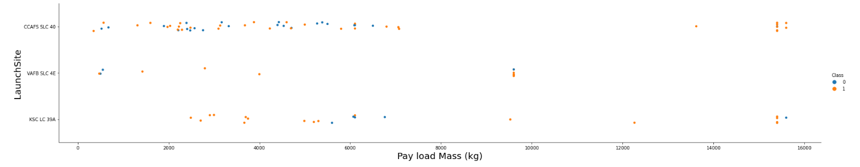
Payload vs. Launch Site
The success rate is increasing with increased payload mass. The highest number of flights has been performed at CCAFS SLC 40.

Slide 20

Success Rate vs. Orbit Type
Success rate for ES-L1, GEO, HEO, and SSO orbit types are the highest. SO has never had any successful launches.

Slide 21
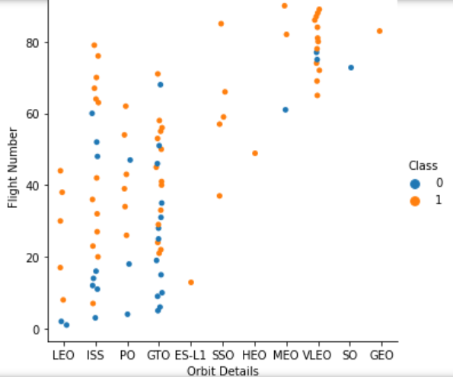
Flight Number vs. Orbit Type
SSO Orbit type has never failed. The success rate for the majority of orbit types has increased with an increased number of flights

Slide 22

Payload vs. Orbit Type
The payload mass greater than 8000 kg shows a high success rate PO and ISS orbit types.
The majority of launches are between 4000 and 8000 payload mass.
The more heavily used orbit type is GTO

Slide 23

Launch Success Yearly Trend
The yearly average success rate keeps growing with time and supposedly continue to develop and grow.

Slide 24
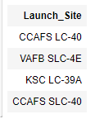
All Launch Site Names
The query to display the names of the unique launch sites in the space mission is as follows:
To get unique site names we use Distinct keyword:

Slide 25
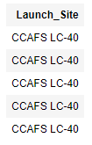
Launch Site Names Begin with 'CCA'
The query to find 5 records where launch sites begin with `CCA` is as follows:
In order to get 5 records we use the LIMIT keyword:

Slide 26
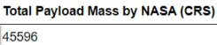
Total Payload Mass
The query to calculate the total payload carried by boosters from NASA is as follows:
In order to get the total payload we use SUM function keyword:

Slide 27
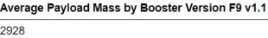
Average Payload Mass by F9 v1.1
The query to calculate the average payload mass carried by booster version F9 v1.1 is as follows:
In order to get average payload mass we use AVG function keyword:

Slide 28
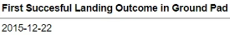
First Successful Ground Landing Date
The query to find the dates of the first successful landing outcome on the ground pad is as follows:
In order to get first successful outcome date we use MIN function keyword:

Slide 29
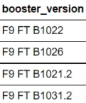
Successful Drone Ship Landing with Payload between 4000 and 6000
The query to get the list of the names of boosters that have successfully landed on a drone ship and had payload mass greater than 4000 but less than 6000 is as follows:
In order to get successfully landed boosters we use keyword BETWEEN 4000 and 6000:

Slide 30
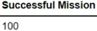
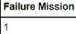
Total Number of Successful and Failure Mission Outcomes
The queries to calculate the total number of successful and failed mission outcomes are as follows:
In order to get success and failure mission outcomes we use COUNT and LIKE “Success%” and “Failure%” keywords:

Slide 31
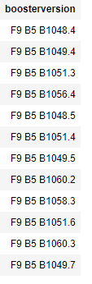
Boosters Carried Maximum Payload
The query to list the names of the booster which have carried the maximum payload mass is as follows:
We use a subquery here to get boosters with maximum payload:

Slide 32
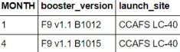
2015 Launch Records
The query to list the failed landing_outcomes in drone ship, their booster versions, and launch site names for the year 2015 is as follows:
We use Date keyword here to choose between month and year:

Slide 33
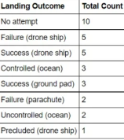
Rank Landing Outcomes Between 2010-06-04 and 2017-03-20
The query to rank the count of landing outcomes (such as Failure (drone ship) or Success (ground pad)) between the dates 2010-06-04 and 2017-03-20, in descending order is as follows:
We use GROUP BY and ORDER BY keywords to consolidate the results:

Slide 34

Section 3

Slide 35
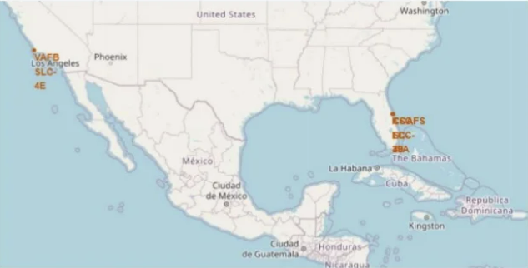
Launch Sites Location Markers – All Sites
Launch sites are located on US coastline (Florida and California)

Slide 36
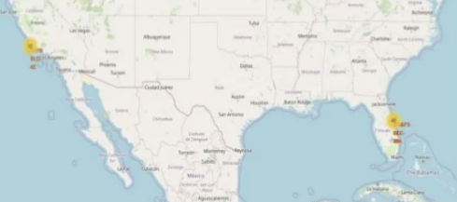

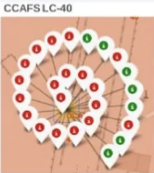
Color-Labeled Launch Outcomes
Folium map illustrates success/failure launch outcomes for 2 sites.
Green color defines successful outcome (Success)
Red color defines unsuccessful outcome (Failure)

Slide 37
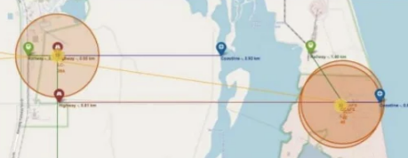
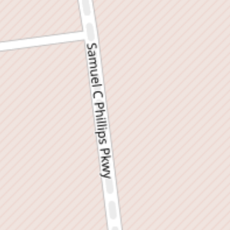
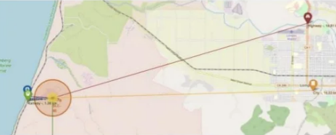

Launch Site Distance to Its Proximities
The calculated distances from launch sites indicate that they are in its relatively closed proximity to railways, highways and costal line

Slide 38

Section 4

Slide 39
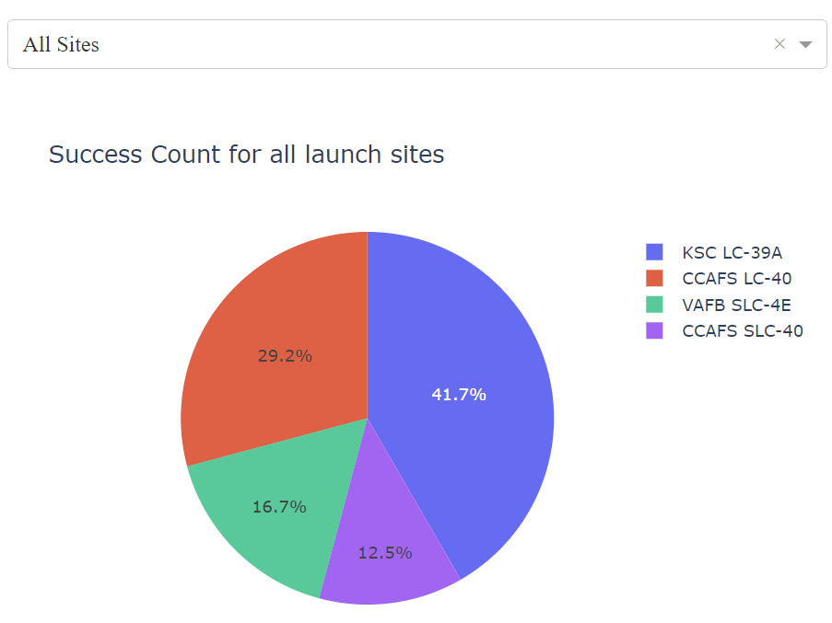
Launch Sites Success Count – All Sites
KSCMLC-39A shows the highest success score of 41.7 %
CCAFS LC-40 has the success score of 29.3 %
CCAFS SLC-40 has the lowest success score of 12.5 %

Slide 40
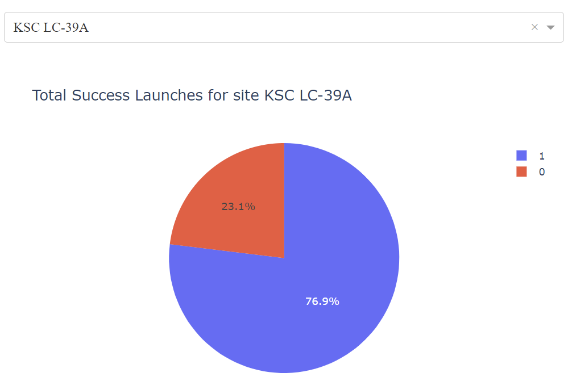
Total Success Launches – Site KSC LC-39A
KSC LC-39A has the highest successful number of launches of 76.9 %
The highest success count in FT Booster version category
The typical payload mass is 2000 – 6000 kg.

Slide 41
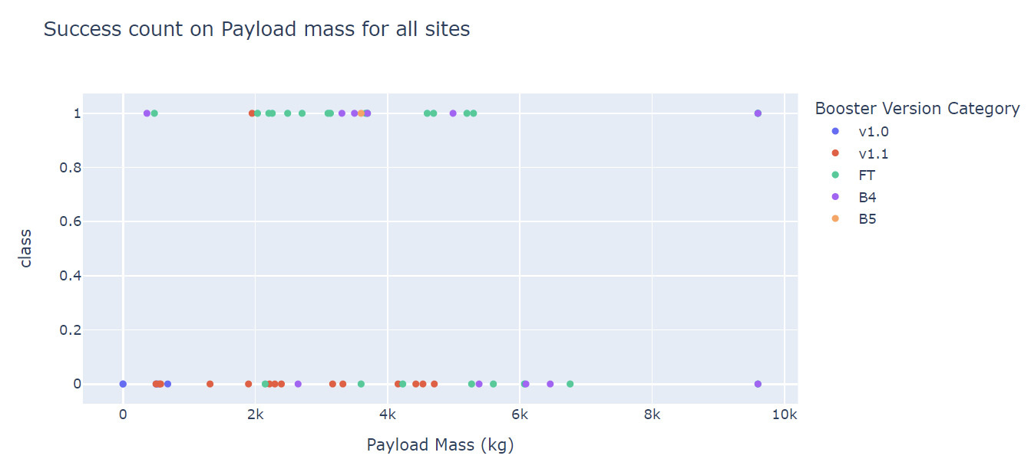
Success Count on Payload Mass – All Sites
The payload mass for all booster version category is between 1000 – 7000 kg.
The highest success count belongs to FT and B4 booster version categories
The payload mass for successful categories is 2000 – 5000 kg.

Slide 42

Section 5

Slide 43
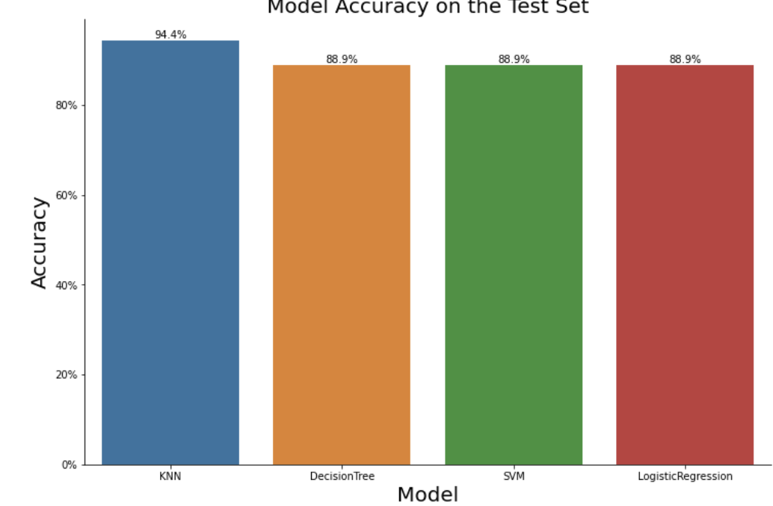
Classification Accuracy
KNN model has the highest classification accuracy

Slide 44
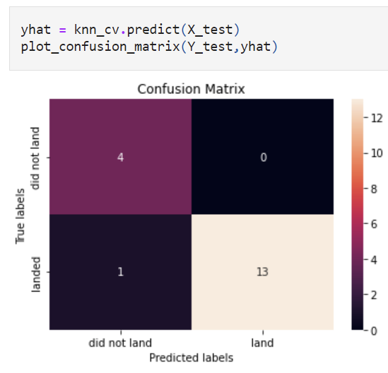
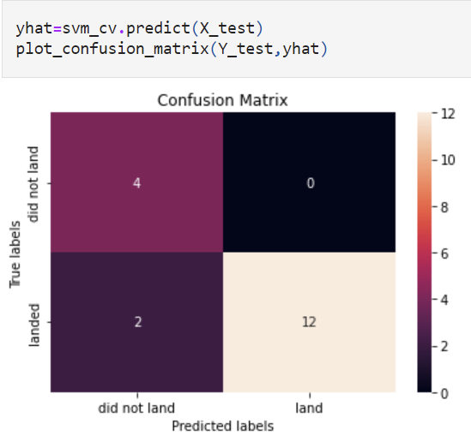
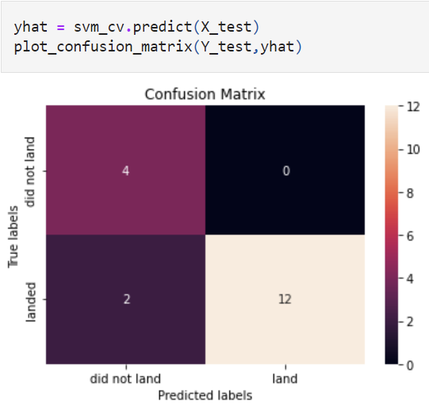
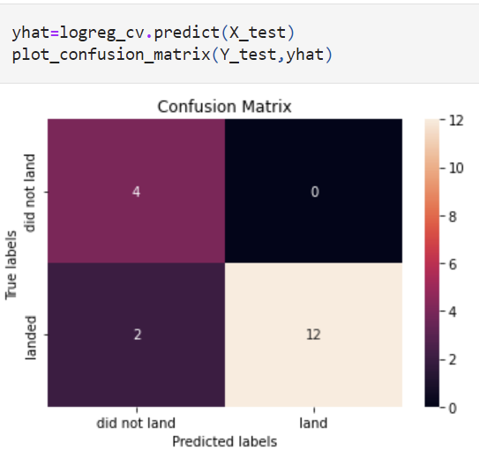
Confusion Matrix
Check out the confusion matrix for the best performing model

Slide 45
Conclusions
Launch site KSC LC-39A has a highest success rate
The payload range 2000 – 5000 kg is more typical for successful launches
Decision Tree model performed the best for the training data set with a score of 0.87.
KNN model showed high accuracy of 94 % on test data set.

Slide 46
Appendix
The repo for this capstone can be found here:
https://github.com/vadimsavenkov/Applied_DS_Capstone

Slide 47


